Slide 2
710eSharkUS
Specifications:
- Fill 100 consumables at a time
- Able to be programmed for various cartridges and mouth pieces
- Movement is accurate to 0.1mm
- Filling accuracy to less than 0.01ml
- Runs on 115 VAC 60 Hz power
- Built in Safety lockouts
- User programable heat, speed and fill volume controls
- Pre-Programmed Cleaning and Purging Routines
- Remote back end access over the internet for Software updates and service
- Footprint dimensions: 78” X 29.50” x 24.00” ( H x D x W)
UL and Canadian UL listed – UL508A
PLUG TYPE: NEMA 5-15P
Cut Sheets Available :

Slide 3
710Captain Capping Machine
SPECIFICATIONS:
- Caps 100 compression cartridges in less than 30 seconds
- CCELL capping capabilities
- No calibration required, plug & play
- Built-in air compressor
- 2-step press process to properly align and lock mouthpieces in place
UL and Canadian UL listed – UL508A
110VAC/15A
FLA: 11A
PLUG TYPE: NEMA 5-15P
Weight: 275lbs - Shipping Weight: 325lbs
Footprint dimensions: 76” X 24” x 25.5” ( H x D x W)
Packaging Dimensions (Palletized): 40 x 48 x 75
Cut Sheets Available :

Slide 4
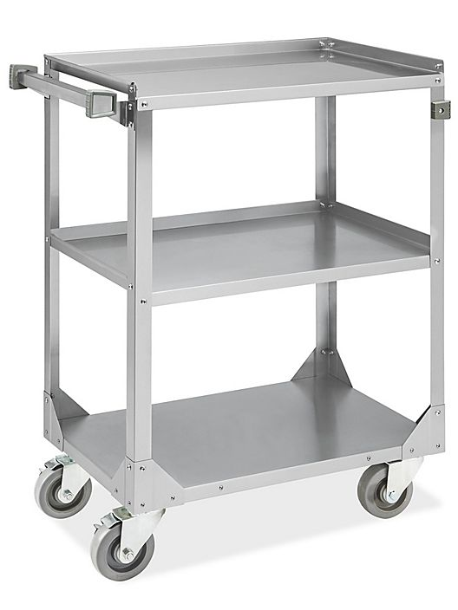
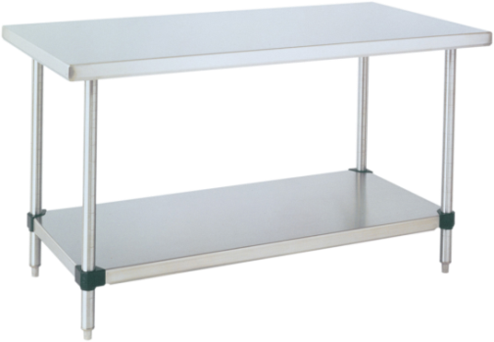
Efficient, Reliable Process - Process Flow
❶ Stack Empty Pens
❷ Load for FILL
❸ Load CAPS
❹ Move to Packaging
100 Pens to Rack
Stack efficiently for access
Streamlined Process
100 Pens Racks
Move to Packaging
710eSharkUS
710Captain Capping Machine
Footprint dimensions:
78” X 29.50” x 24.00” ( H x D x W)
Footprint dimensions:
76” X 24” x 25.5” ( H x D x W)

Slide 5
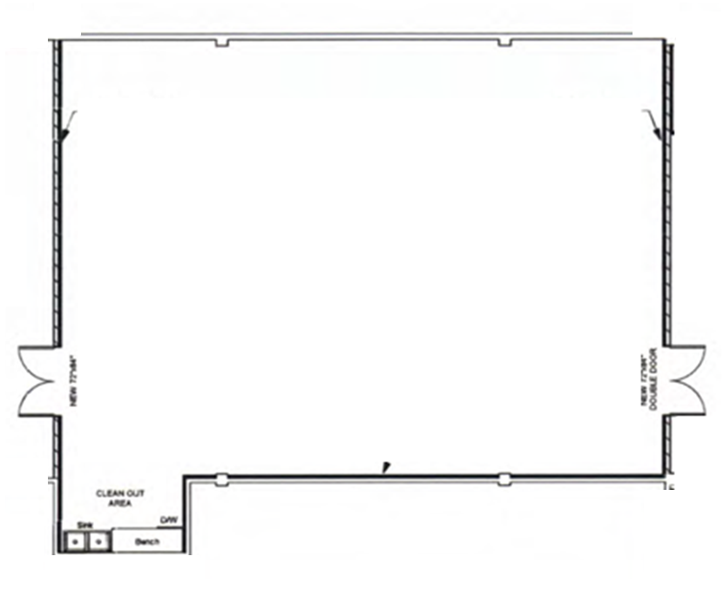
Manufacturing / Packaging: 12 ft x 8 ft
Sample Floor Plan – Process Work Flow and Space Allocation
Electrical: If Wall Clearance (Not up against Wall)
Fed Overhead
Cord Real – Machine Mount
Saw Cut Slab
12 ft
2ft
2ft
2ft
2.5ft
2.5ft
FILL
CAP
2ft
2ft
❷
❸
8ft
8ft
6ft
6ft
❶
PRE
❹
POST
10 ft x 8 ft
ROOM
NOT TO
SCALE
Electrical Point of Entry
Single Operator
1. Area to unpack pre-racked trays of Cartridges
2. Filling Machine
3. Capping Machine
4. Area to prepare fully filled and capped Cartridges to be packaged

Slide 6
Equipment
Financing
710eSharkUS
Qualified, Credit Worthy customers
Equipment Financing Available
Pay out of Cash Flow vs Upfront Capital Outlay

